Slide 1




Understanding Student Well-being A Holistic Approach

Slide 2
Table of contents
01
Introduction
02
Problem Statement
03
Data Collection
04
Data Analysis
05
Solution
1

Slide 3
01
Introduction
2

Slide 4
In the IEEE SMC & EdSoc Challenge 2023, we delve into data to uncover the impact of social relationships, health, and emotional resilience on academic success. Beyond analysis, we offer actionable strategy for improving student well-being and resilience, contributing to a brighter future.
Join us on this journey as we share insights and strategies for a holistic understanding of student well-being.
3

Slide 5
02
Problem statement
4

Slide 6


20%
77%
Students are particularly vulnerable to high levels of stress. Independent learning, new social pressures and dealing with adult responsibilities can all weigh heavily on student minds. According to the World Health Organization (WHO)
Of the world's adolescents have a mental health condition including conditions like ADHD, autism, depression, anxiety, and eating disorders.
College students experienced moderate to serious psychological distress.
Tunisia ranks third in Africa for depression cases, impacting over 500,000 people
5

Slide 7
Comprehensive analysis of the factors provoking issues related to student well-being.
Data collection workflow aiming to delve into the nuanced dimensions of student experiences.
By examining academic, social, and personal aspects, we seek to identify key stressors and challenges
We’ll propose a solution to foster a positive and nurturing atmosphere that enables students to thrive academically and personally.
6

Slide 8

03
Data Collection
7

Slide 9
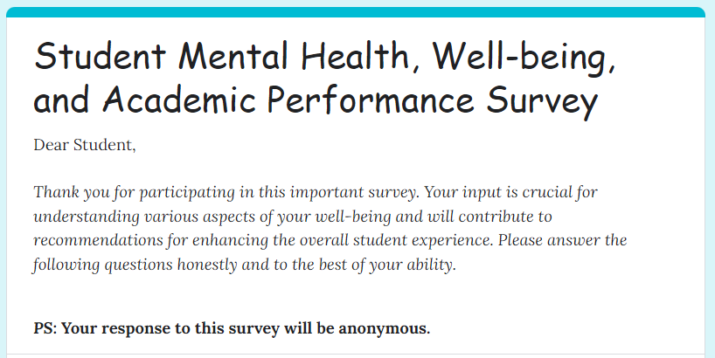
Data Gathering: Google Forms Approach
Survey Participation
A purpose-designed form, comprising six distinct rubrics was disseminated among students from various fields of study and age groups.
Data Collection Period : The survey was conducted during a period of 1 week to capture a diverse range of responses.
Survey Participants : A total of 130 students actively participated in the survey The participants were drawn from various fields of study and different academic levels, contributing to the richness and diversity of the collected data.
Overview of Collected Data: To streamline the data collection process, Google Sheets was employed as the primary platform for survey responses.
8

Slide 10

04
Data Analysis
9

Slide 11
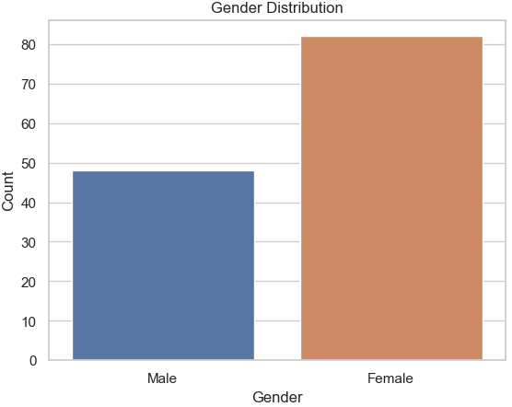
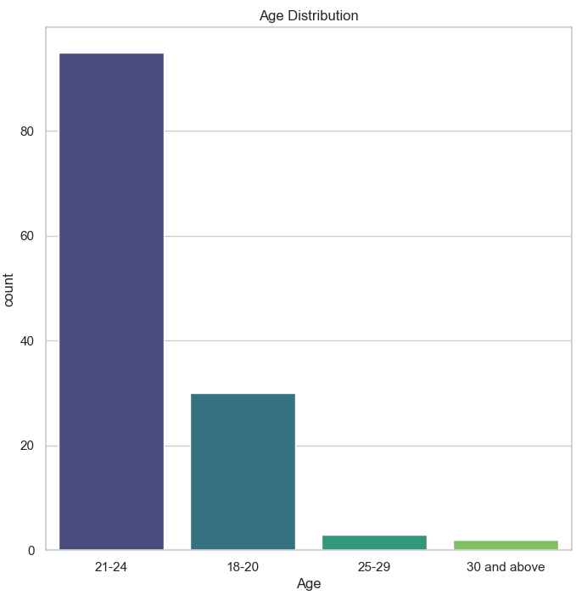
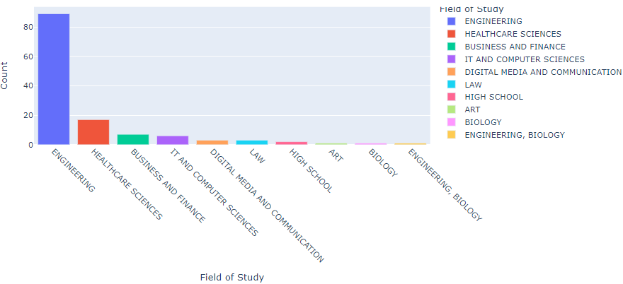
Demographic Distribution
Types of distributions
Gender Distribution
Age Distribution
Fields of Study
10

Slide 12
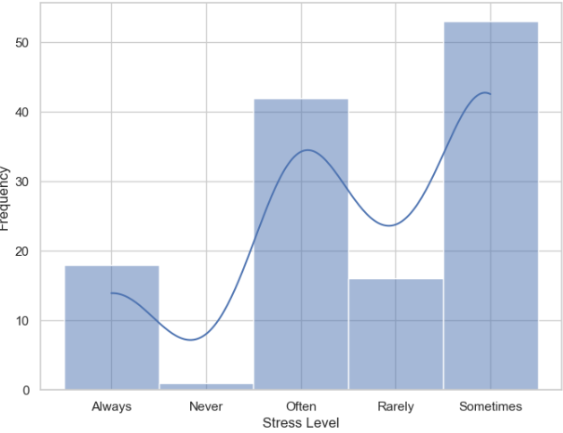
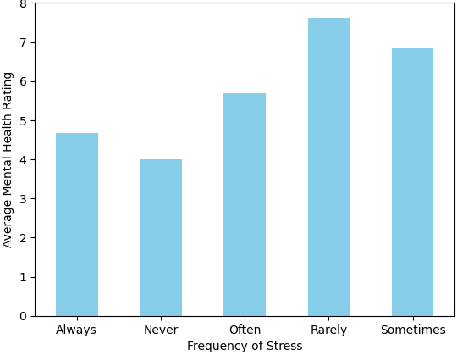
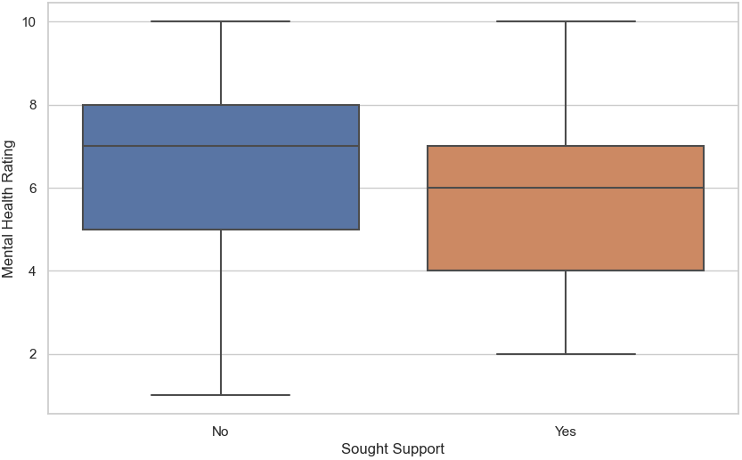
Mental Health Analysis
Distribution of Stress Levels | Average Mental Health Ratings for Different Stress Levels | Comparison of Mental Health Ratings for those who Sought Support vs. those Who Didn’t
11
Average Mental Health Rating = 6.238462

Slide 13
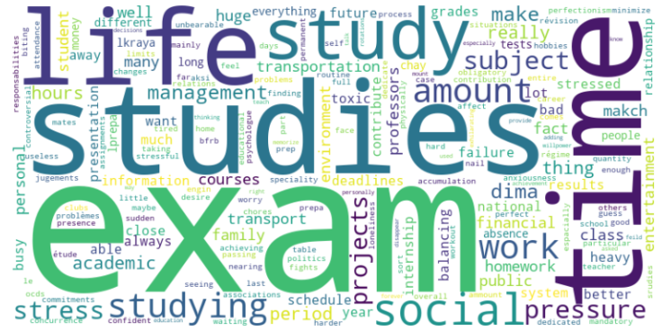
Factors contributing to stress or anxiety
Work
Studies
Job pressures, balancing employment.
Academic pressure, demanding coursework.
Family
Exams
Familial expectations, home challenges.
Performance anxiety, exam stress.
Finances
Time
Financial stress, cost concerns.
Juggling commitments, time constraints
12

Slide 14
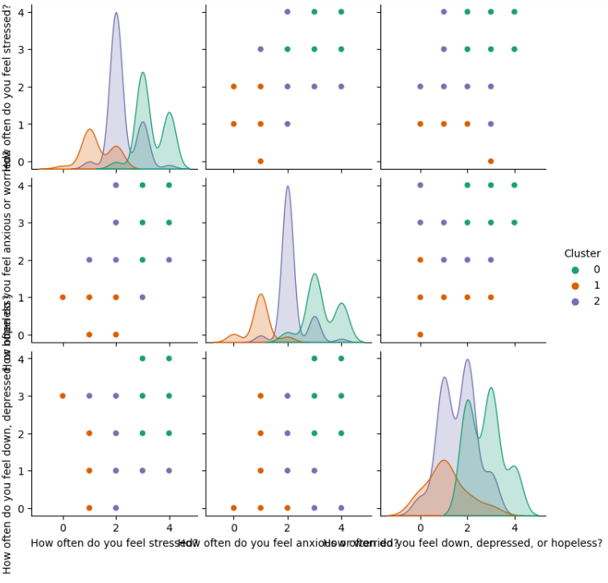
Cluster analysis using k-means
Cluster analysis involves grouping participants into clusters based on similarities in their responses to identify patterns of mental health.
We used the responses to the questions
’How often do you feel stressed?’,
’How often do you feel anxious or worried?’,
’How often do you feel down, depressed, or hopeless?’
13

Slide 15
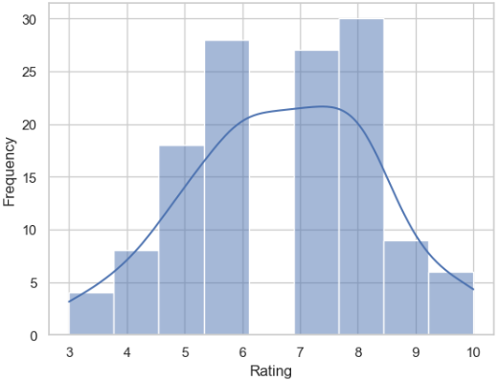
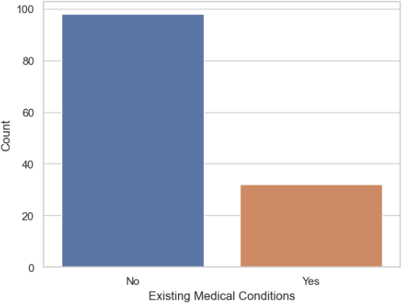
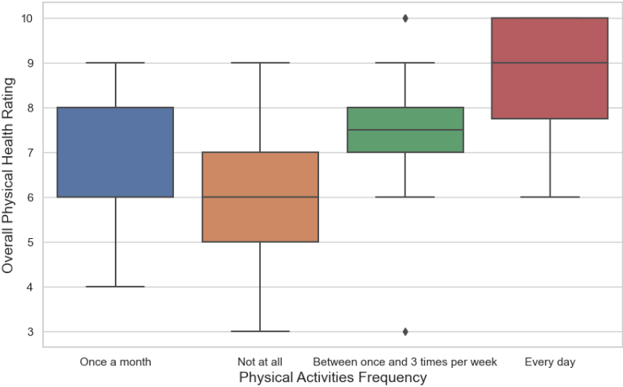
Physical Health Analysis
Physical Health Distribution | Existing Medical Conditions | Relationship between Physical Activity and Physical Health
Average Mental Health Rating = 6.707692
14

Slide 16
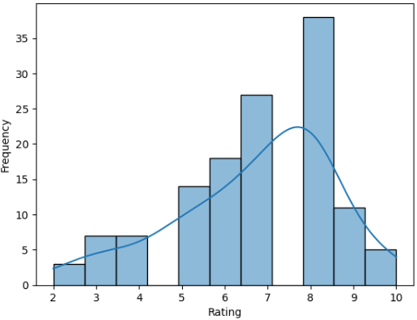
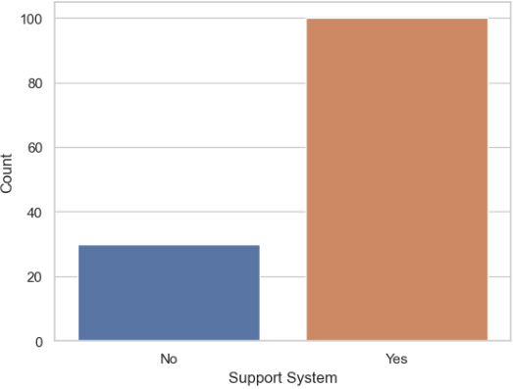
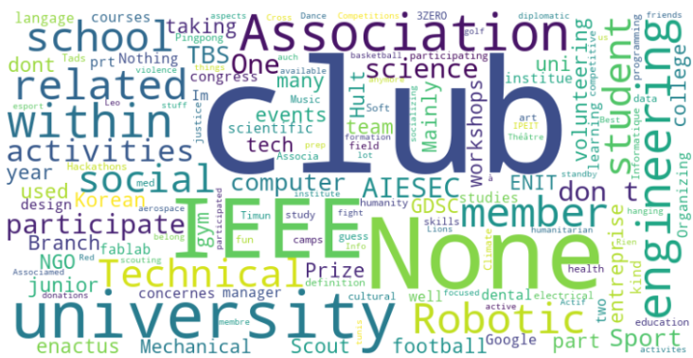
Social Relationships Analysis
Social Relationships Rating Distribution | Support System Count | Types of social activities or clubs Students are involved in
Average Social Relationships Quality = 6.730769
15

Slide 17
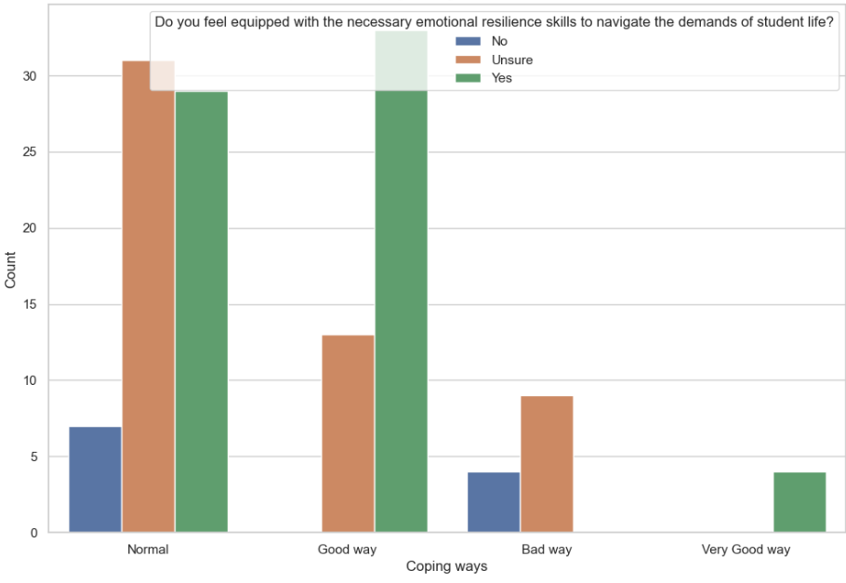
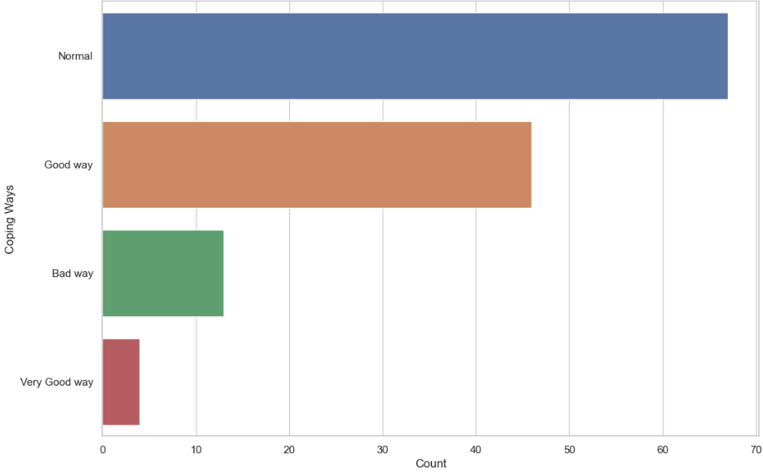
Emotional Resilience Analysis
Coping with challenges and setbacks | Relationship between Coping Strategies and Emotional Resilience Skills
16

Slide 18
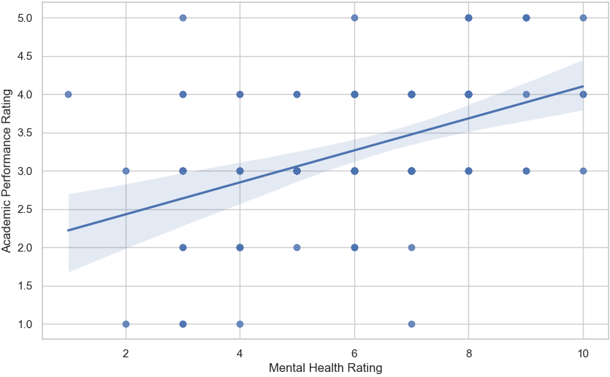
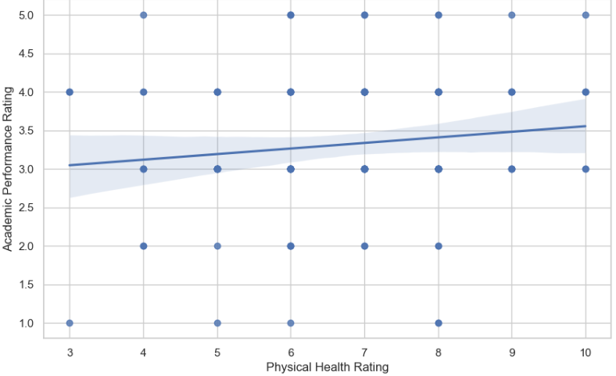
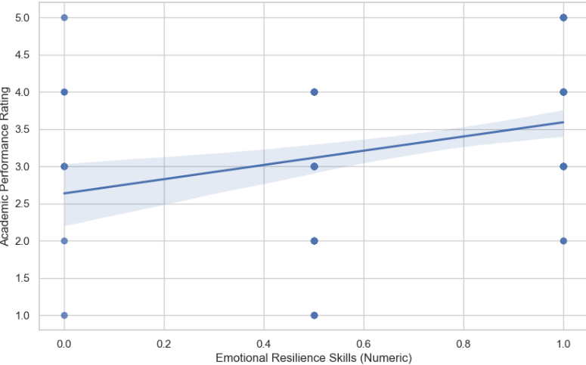
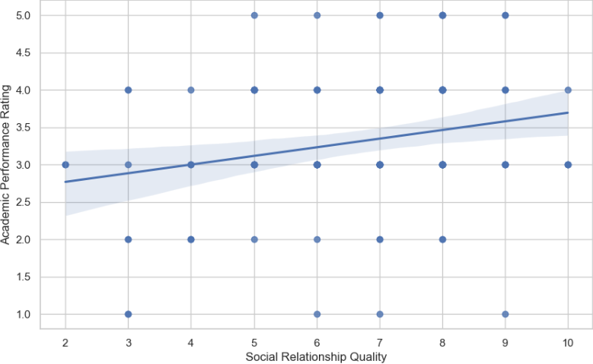
Correlation
17

Slide 19
05
Our Solution
18

Slide 20
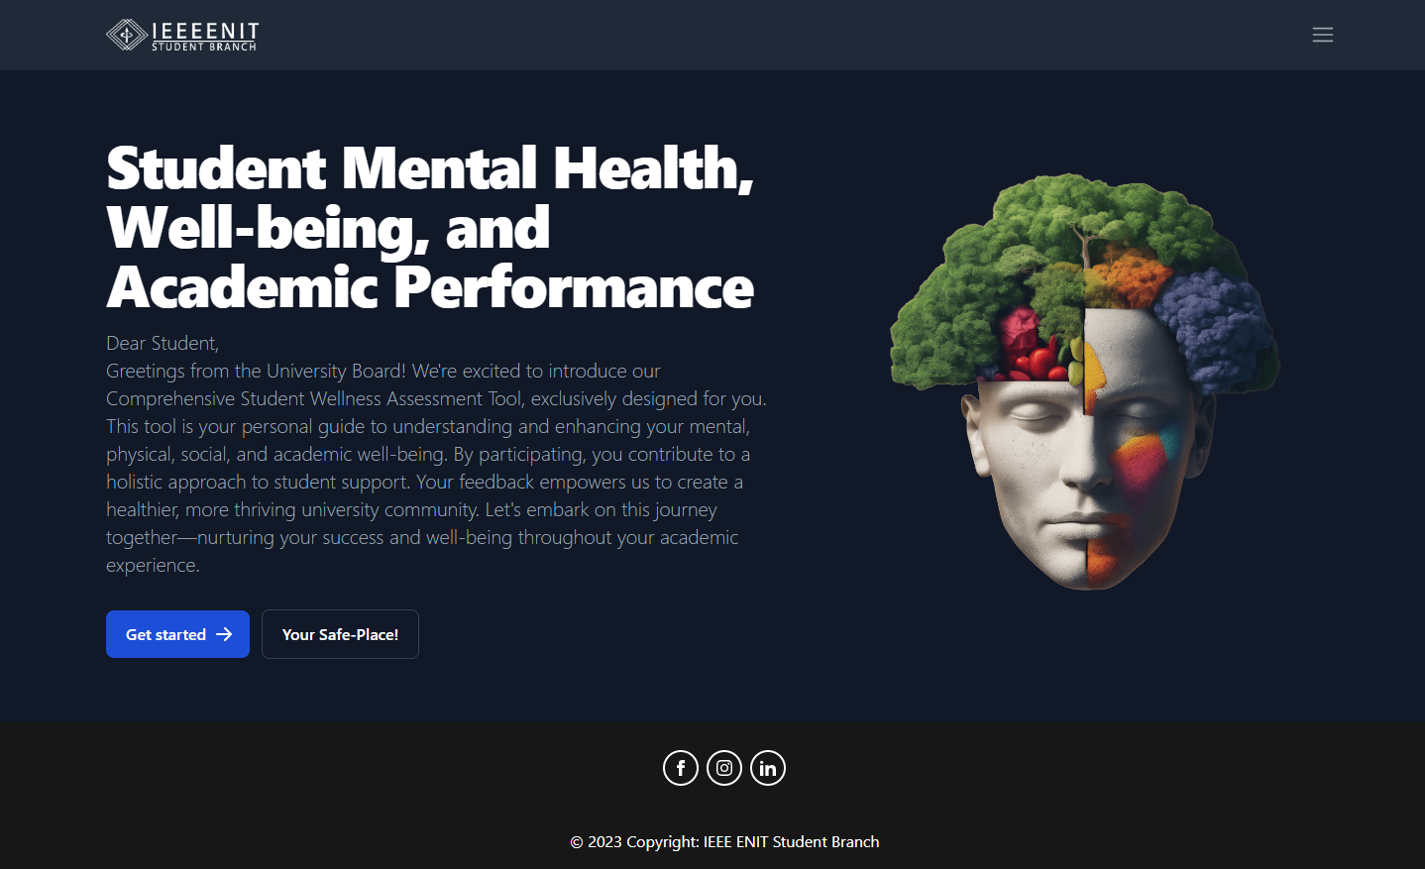
An Innovative React JS-Driven Solution
This dynamic platform is expressly designed to address the unique needs of each individual within institutions and universities.
19

Slide 21
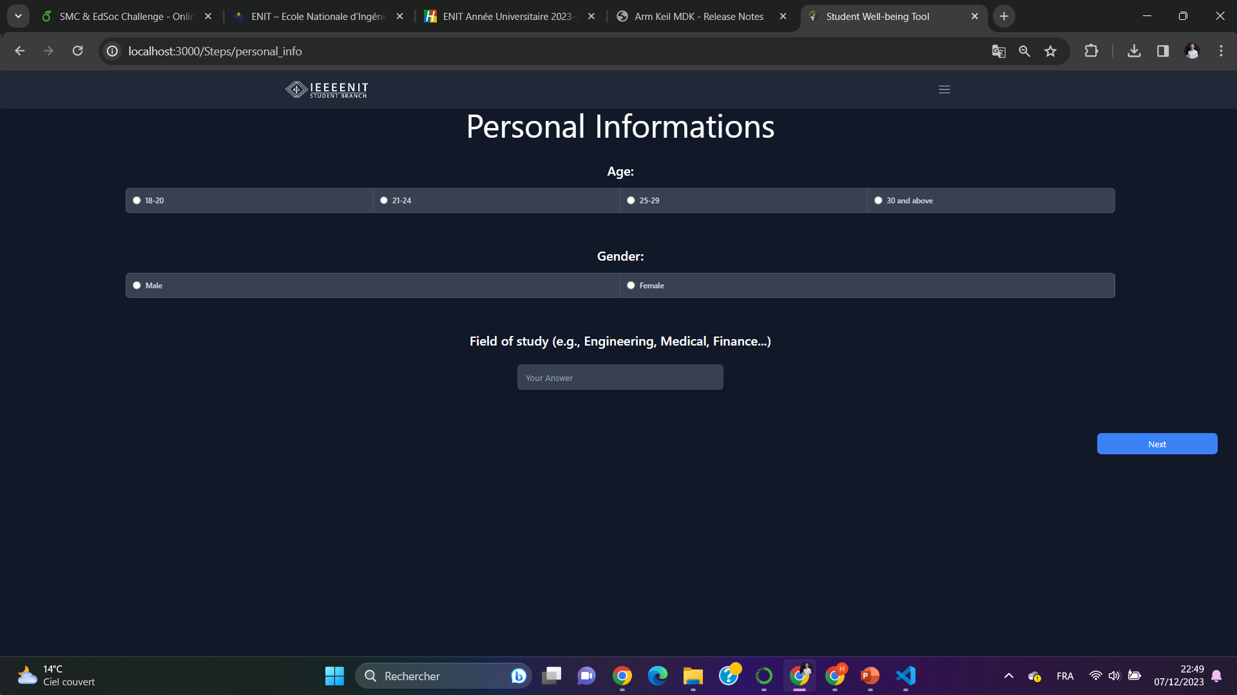
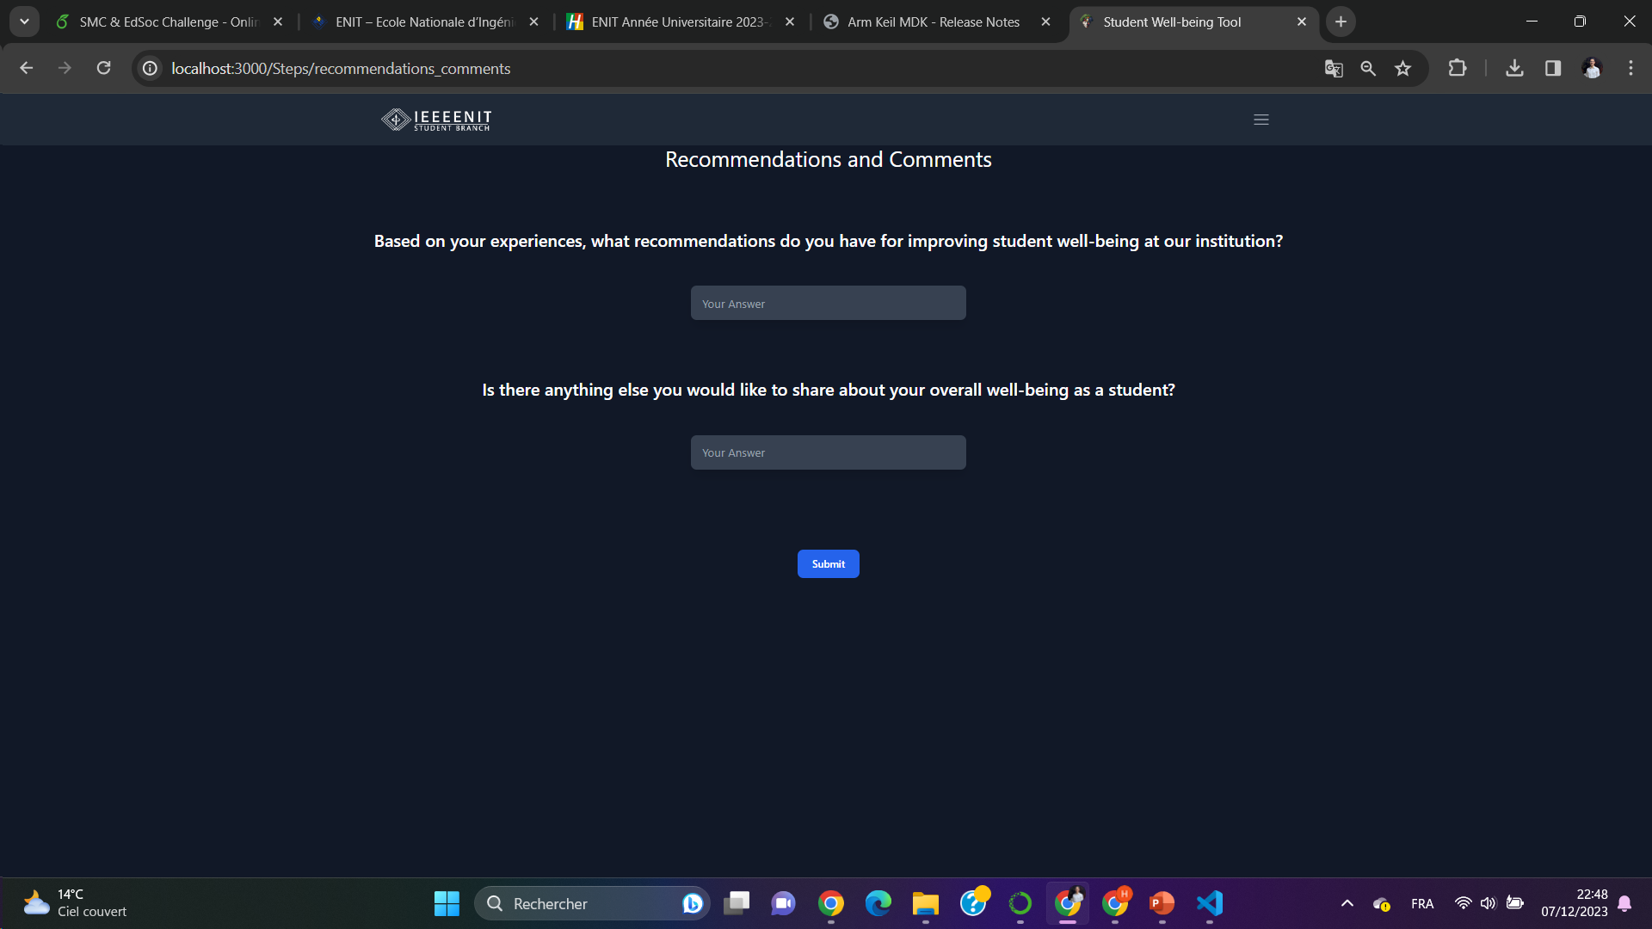
By adding our survey to the tool, it serves as a crucial resource for university boards and administrators, offering a detailed overview of the mental and physical health, social connections, emotional resilience, and academic performance of each student,
20

Slide 22
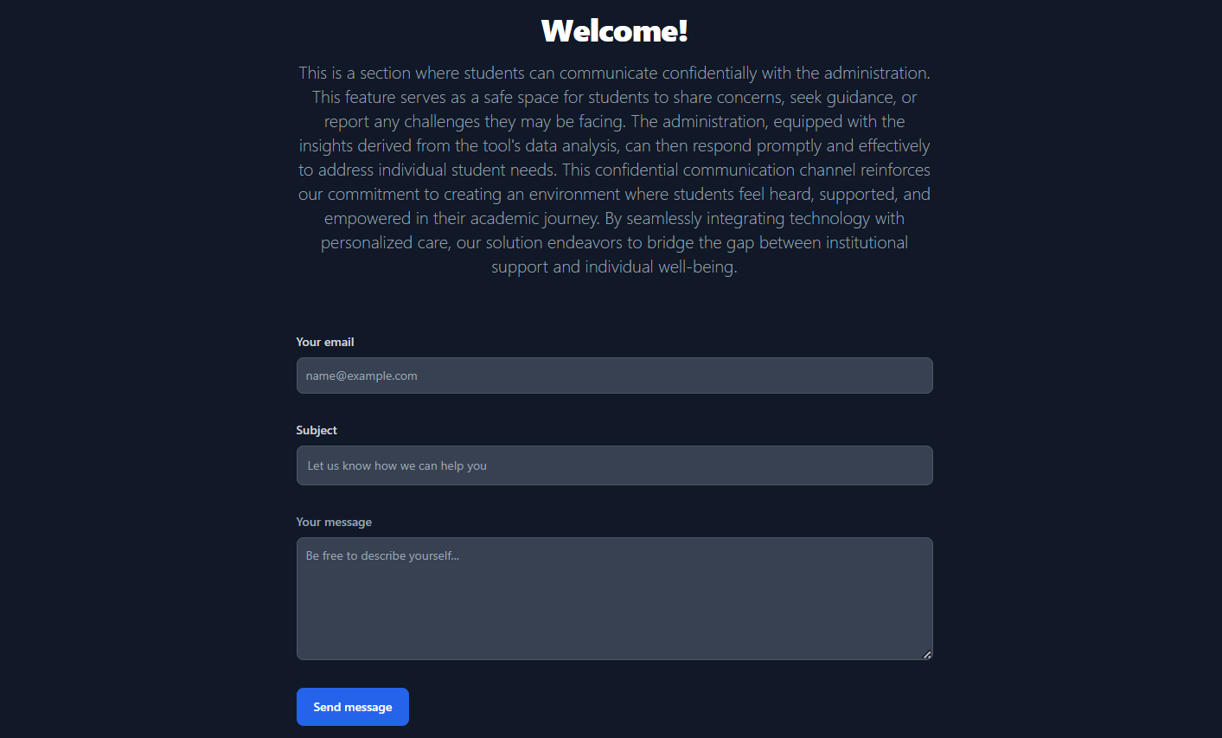
We’ve incorporated a dedicated section where students can communicate confidentially with the administration. This feature serves as a safe space for students to share concerns, seek guidance, or report any challenges they may be facing.
21

Slide 23
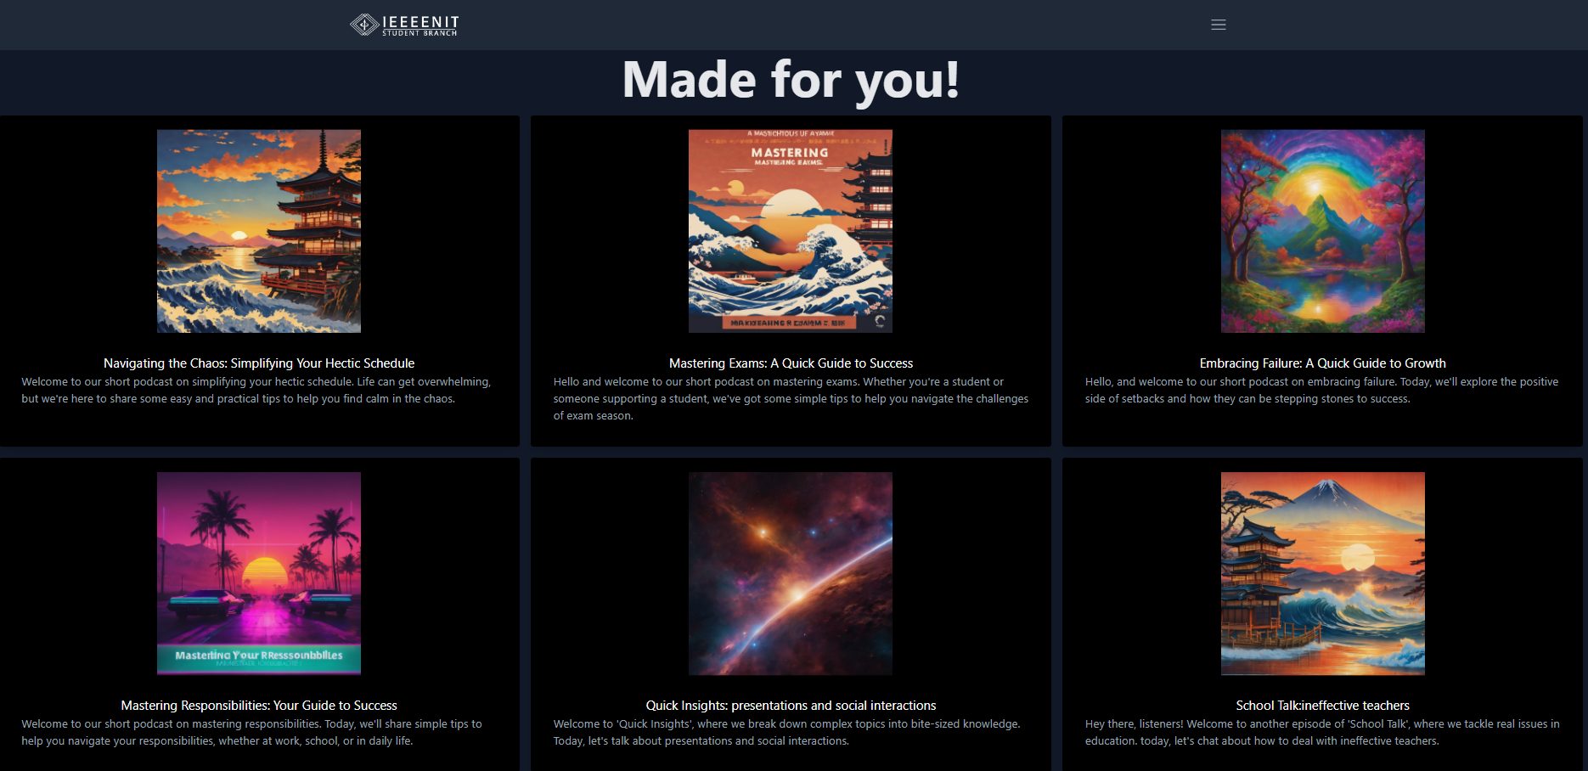
The platform offers an engaging and curated selection of podcasts, each addressing specific themes such as stress, anxiety, and overall mental health.
22

Slide 24
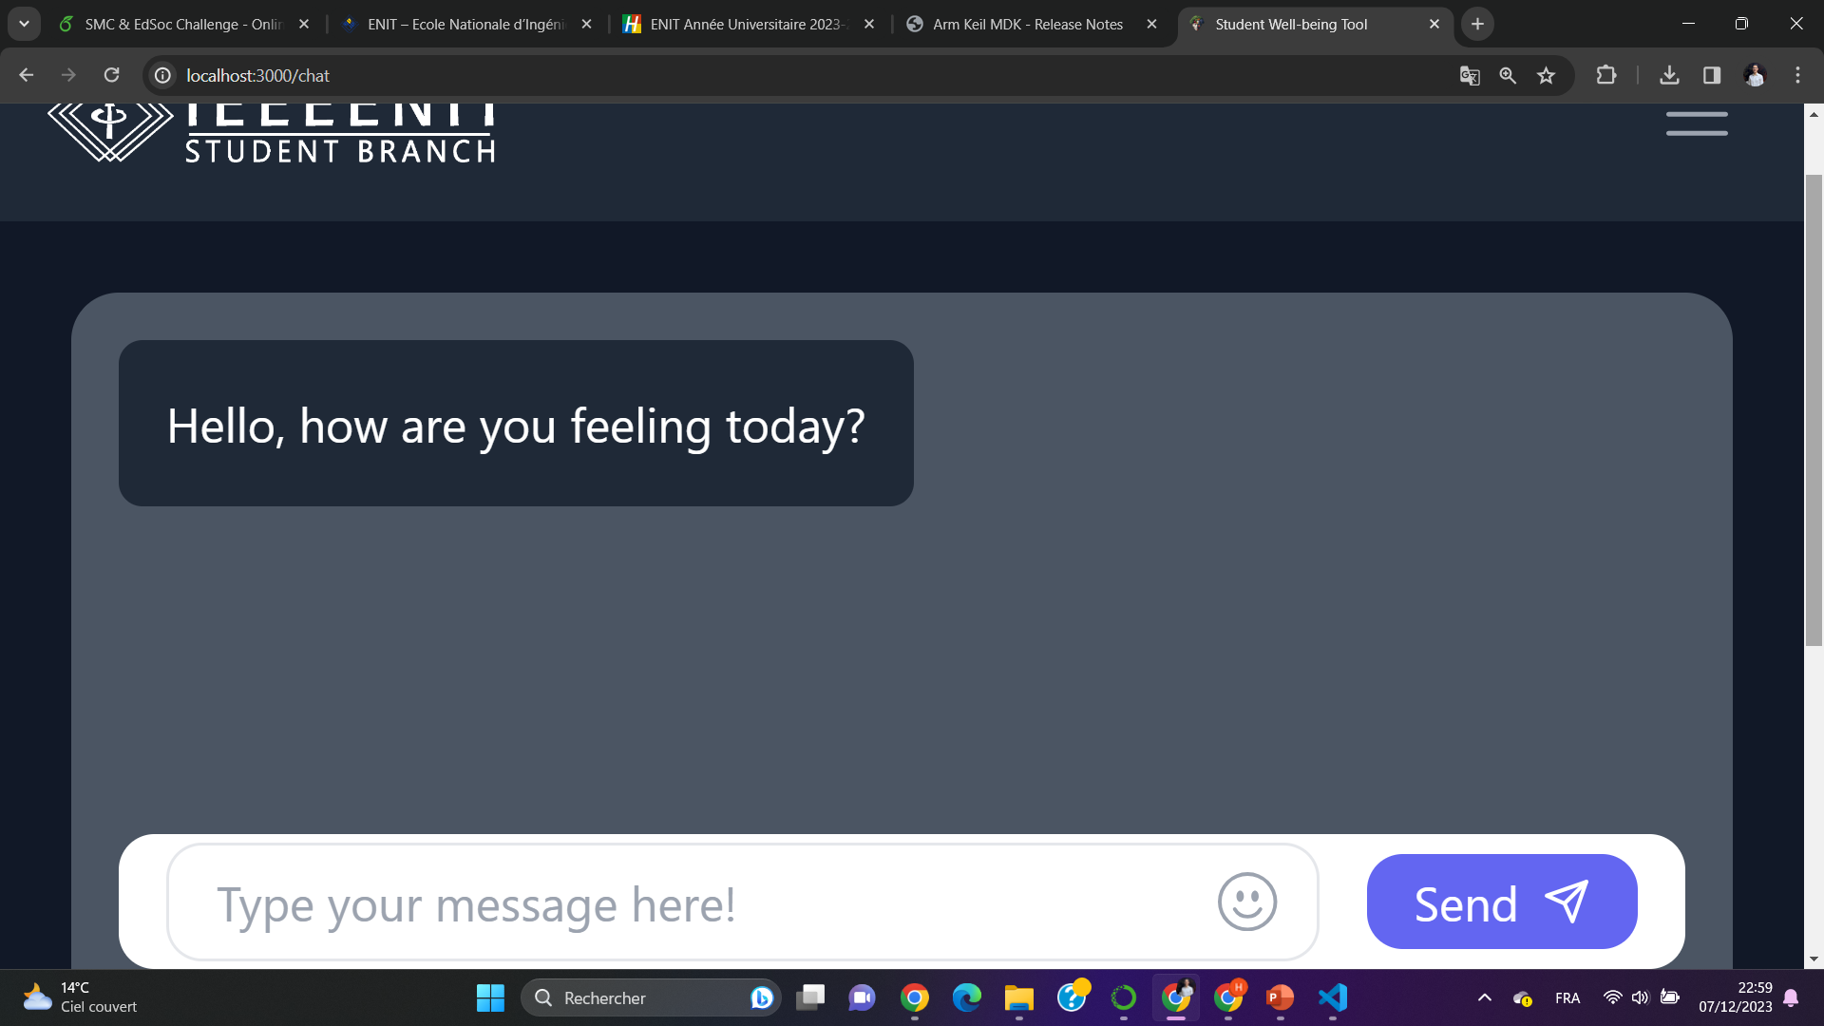
Finally, we’ve integrated into the platform, a chatbot that provides students with immediate access to mental health support.
23

Slide 25
Thank You
24

